Slide 1
TraceLab Components for Reproducing Source Code Summarization Experiments
ICSME 2016 – Artifacts
Breno D. Cruz, Paul W. McBurney and Collin McMillan.
Notes:
Summary

Slide 2
Summary
Reproducibility package for experiments in source code summarization
Conversion of two techniques for source code summarization to be used in TraceLab
Creation of a set of components for the TraceLab infrastructure

Slide 3
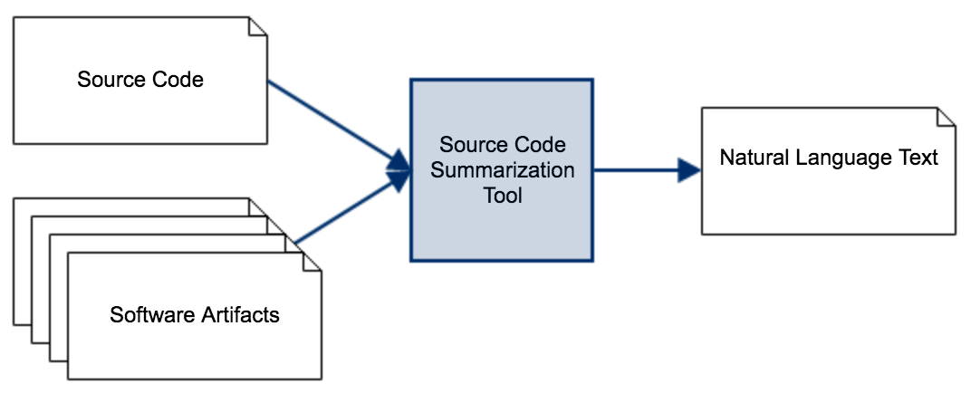
Source Code Summarization
The process of creating natural language descriptions of source code
Notes:
The input to a source code summarization technique is source code plus other software artifacts. The output is natural language text which describes the behavior of, purpose behind, and/or details in that source code.

Slide 4
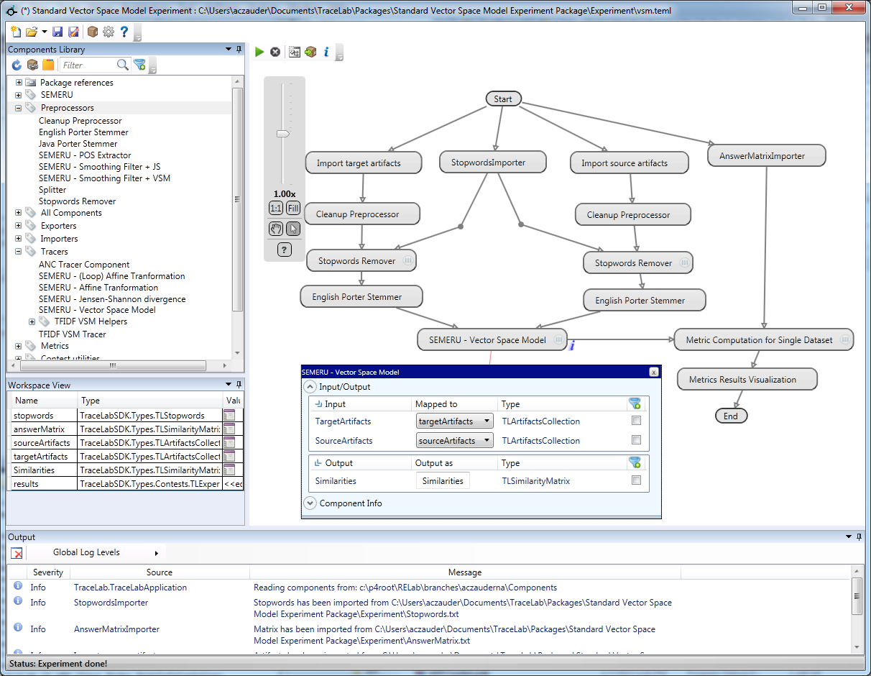
TraceLab
http://coest.org/index.php/tracelab/tracelab-download
Notes:
Environment for traceability of software experiments
An experiment is composed by a set of components
Which can receive input from the user or from a previous components
Components are connected by these relationship connectors

Slide 5
Main Output
Ported two techniques for source code summarization to TraceLab
Abstractive
Extractive

Slide 6
Extractive Technique
Rodeghero et al. – An Eye-Tracking Study of Java Programmers and Application to Source Code Summarization
Higher scores to common key words particular to a method, but rare through the source code
Notes:
For example the word parse it may be only use inside a requirement
while the word xml is used through the code

Slide 7
Extractive Technique
Follow the previously described procedure
Main modifications
Different weights to where the keywords are located in the source code
Method Signature
Control flow
Method Invocation
Notes:
discuss and demo Paige's experiment
Term frequency-inverse document frequency
When it was published?

Slide 8
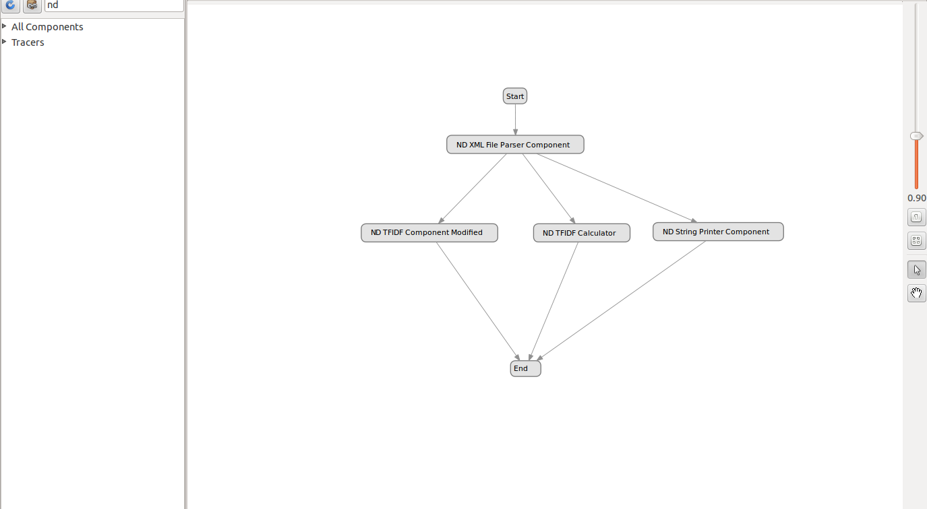
Modified VSM TF/IDF
Notes:
Add additional screenshots

Slide 9
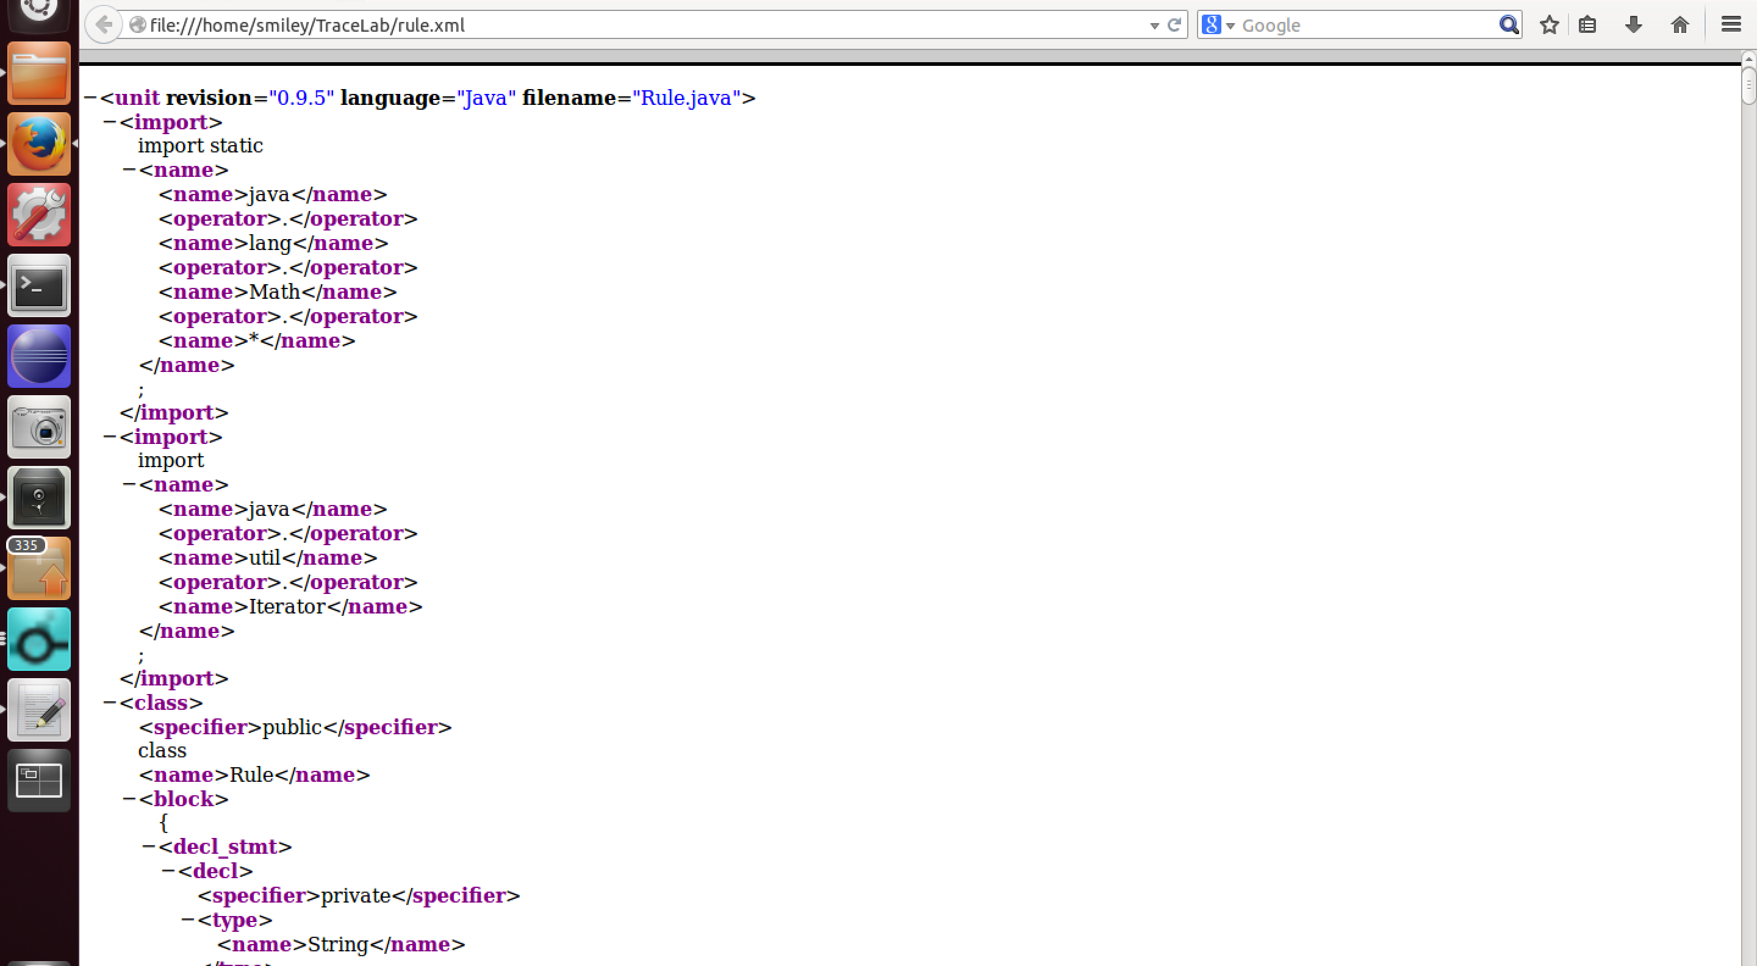
Input

Slide 10
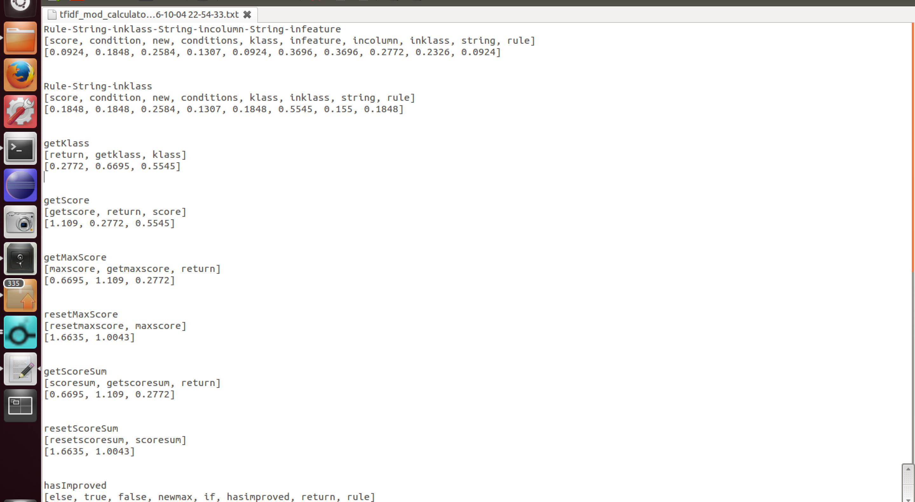
Output

Slide 11
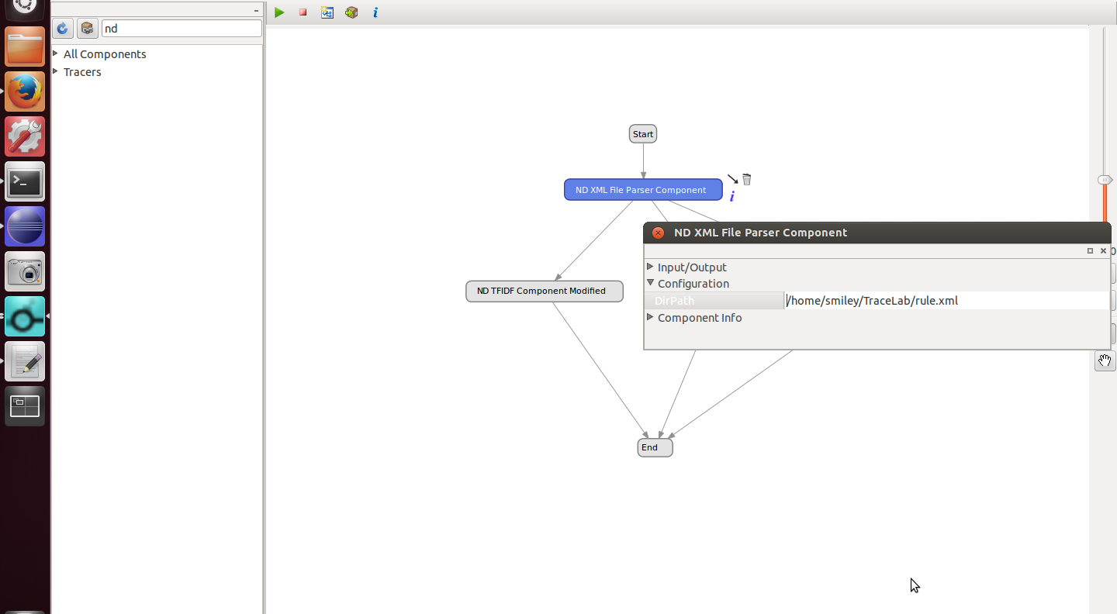
ND XML File Parser Component

Slide 12
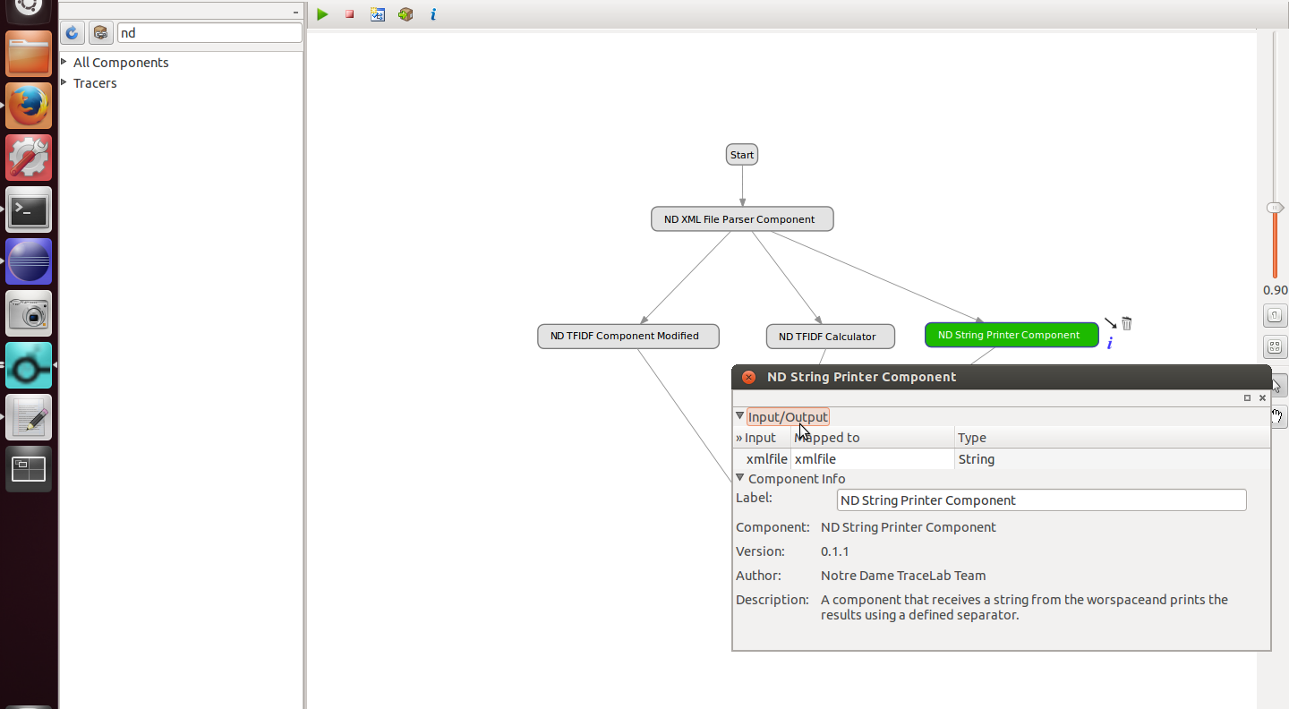
ND String Printer Component

Slide 13
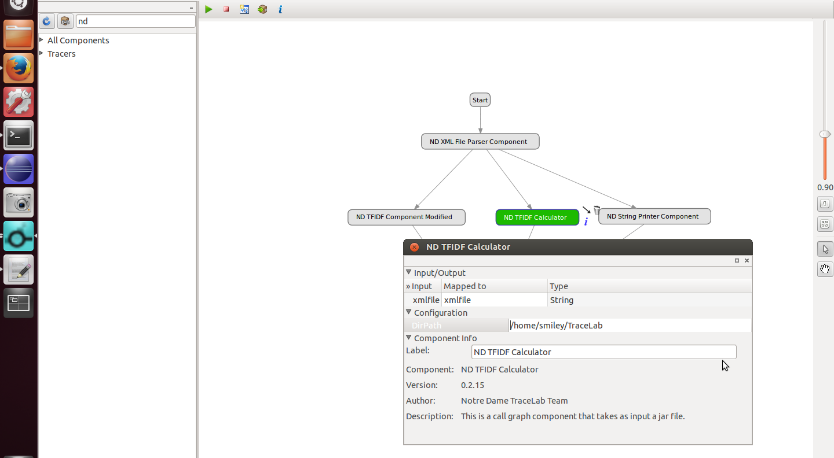
ND TF/IDF Calculator

Slide 14
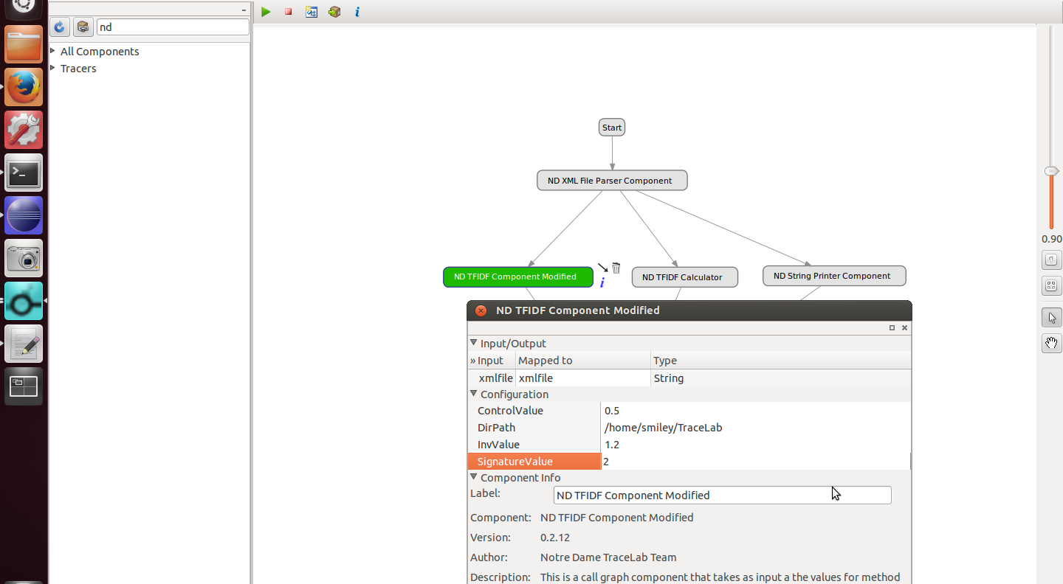
ND TF/IDF Component Modified

Slide 15
Abstractive Technique
McBurney et al. Automatic Source Code Summarization of Context for Java Methods
Provide high-level summaries of a method and its context
Step-by-Step execution:
Collect contextual data about Java methods
Notes:
discuss and demo Will's experiment:
Use PageRank to discover the most important methods in the given method’s context
Use data from swum to extract keywords about actions performed by those most important methods
Use a custom NLG system to generate English sentences describing for what the given method is used

Slide 16
Abstractive Technique
McBurney et al. Automatic Source Code Summarization of Context for Java Methods
Provide high-level summaries of a method and its context
Step-by-Step execution:
Collect contextual data about Java methods
Use key words to describe how a method is used
Notes:
discuss and demo Will's experiment:
Use PageRank to discover the most important methods in the given method’s context
Use data from swum to extract keywords about actions performed by those most important methods
Use a custom NLG system to generate English sentences describing for what the given method is used

Slide 17
Abstractive Technique
McBurney et al. Automatic Source Code Summarization of Context for Java Methods
Provide high-level summaries of a method and its context
Step-by-Step execution:
Collect contextual data about Java methods
Use key words to describe how a method is used
Use SWUM to identify parts-of-speech for the different keywords
Notes:
discuss and demo Will's experiment:
Use PageRank to discover the most important methods in the given method’s context
Use data from swum to extract keywords about actions performed by those most important methods
Use a custom NLG system to generate English sentences describing for what the given method is used

Slide 18
Abstractive Technique
McBurney et al. Automatic Source Code Summarization of Context for Java Methods
Provide high-level summaries of a method and its context
Step-by-Step execution:
Collect contextual data about Java methods
Use key words to describe how a method is used
Use SWUM to identify parts-of-speech for the different keywords
Use PageRank to compute the call graph
Notes:
discuss and demo Will's experiment:
Use PageRank to discover the most important methods in the given method’s context
Use data from swum to extract keywords about actions performed by those most important methods
Use a custom NLG system to generate English sentences describing for what the given method is used

Slide 19
Abstractive Technique
McBurney et al. Automatic Source Code Summarization of Context for Java Methods
Provide high-level summaries of a method and its context
Step-by-Step execution:
Collect contextual data about Java methods
Use key words to describe how a method is used
Use SWUM to identify parts-of-speech for the different keywords
Use PageRank to compute the call graph
Generate a readable description of the context for each method in a java program
Notes:
discuss and demo Will's experiment:
Use PageRank to discover the most important methods in the given method’s context
Use data from swum to extract keywords about actions performed by those most important methods
Use a custom NLG system to generate English sentences describing for what the given method is used

Slide 20
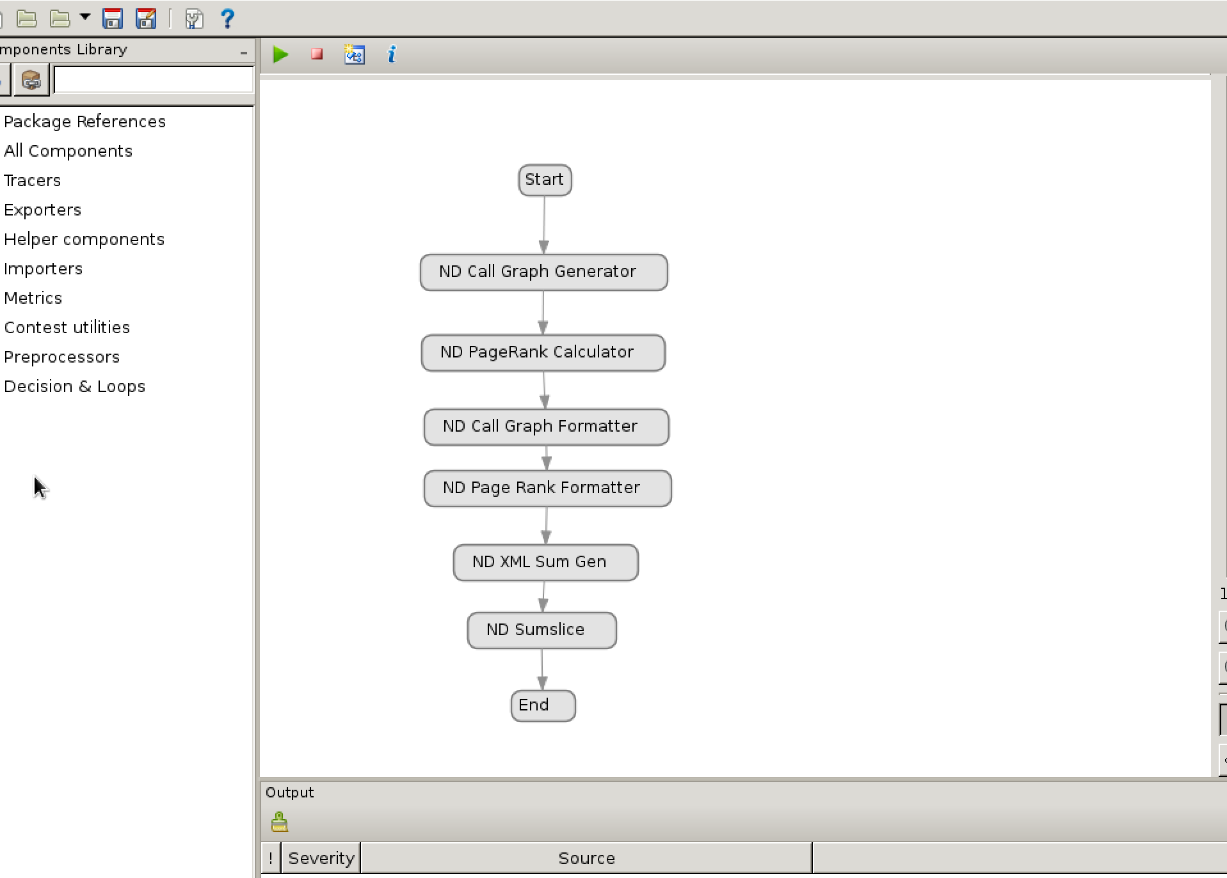
Natural Language Generation System
Notes:
Add screenshots

Slide 21
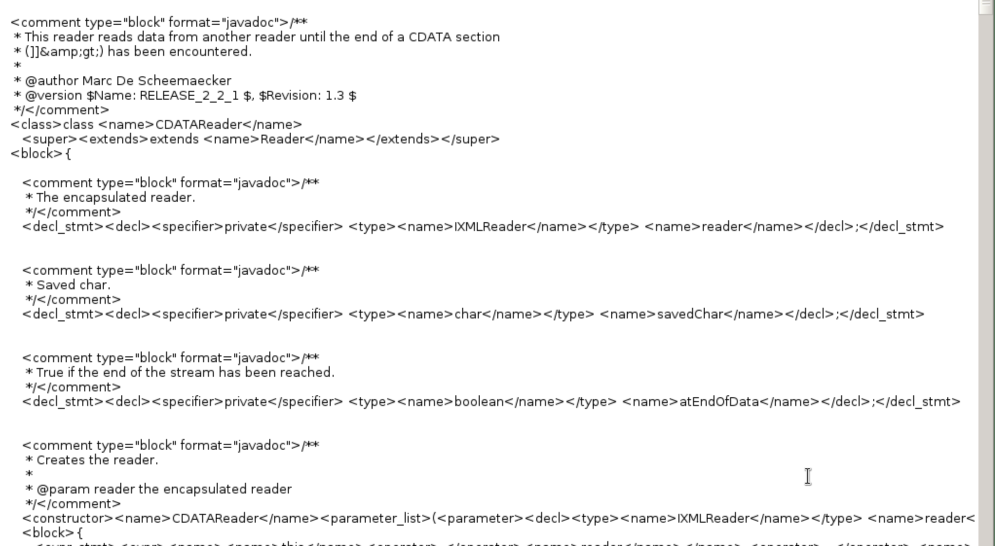
Input

Slide 22
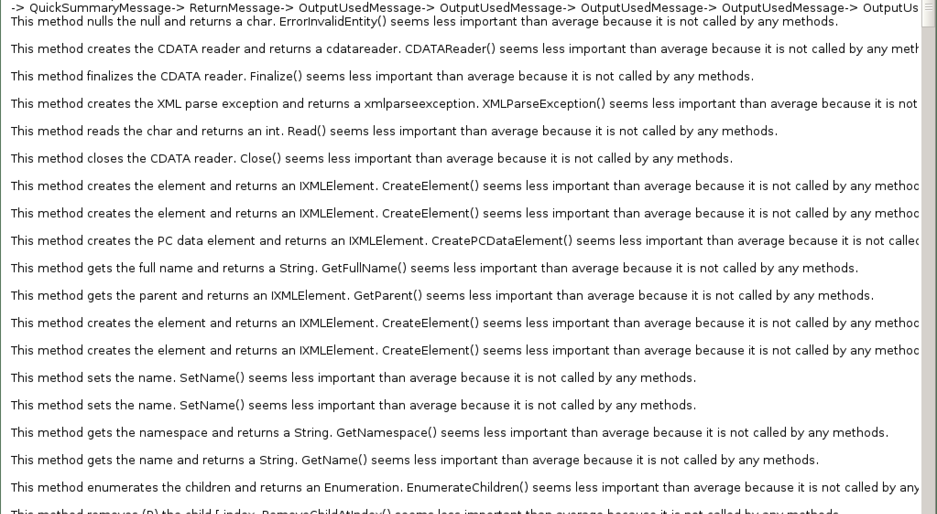
Output

Slide 23
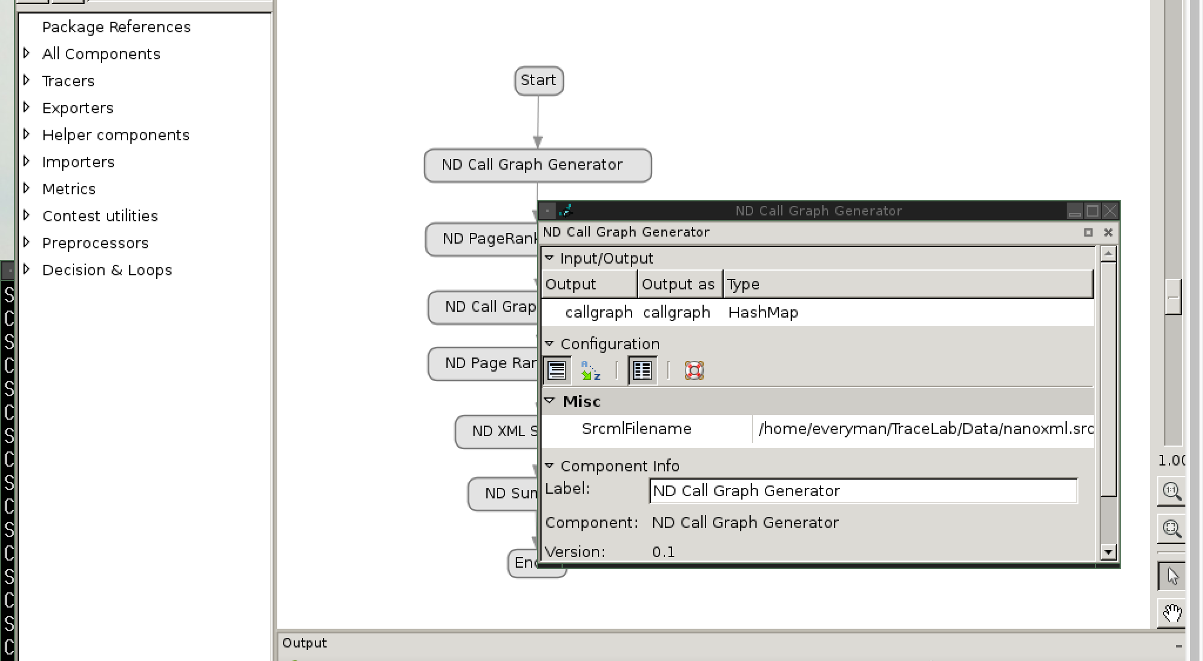
ND Call Graph Generator

Slide 24
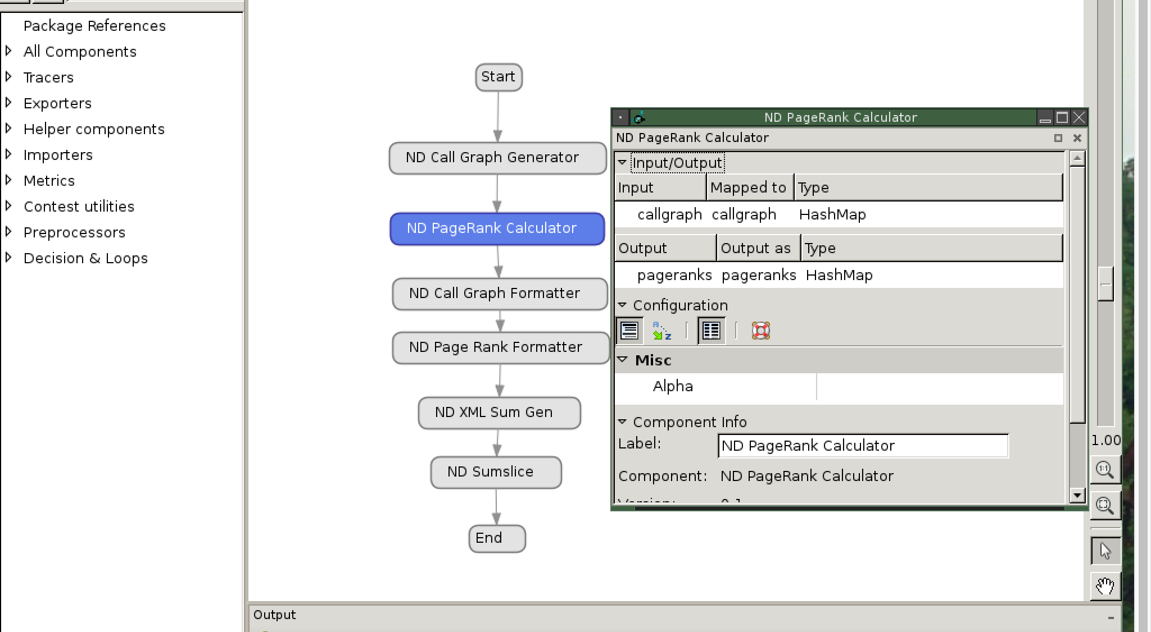
ND PageRank Calculator

Slide 25
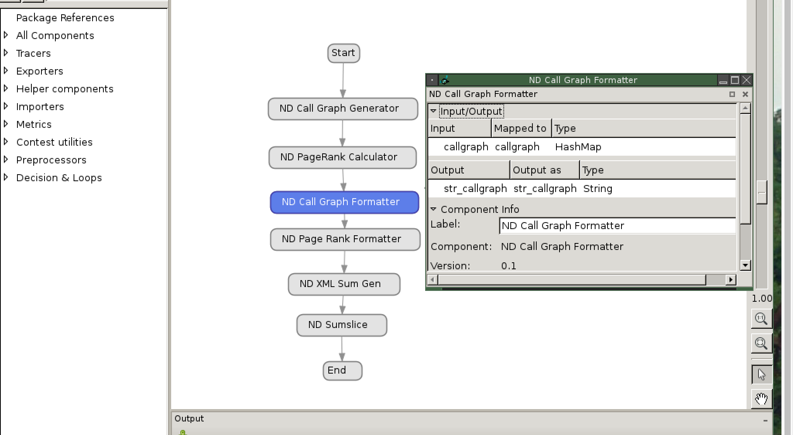
ND Call Graph Formatter

Slide 26
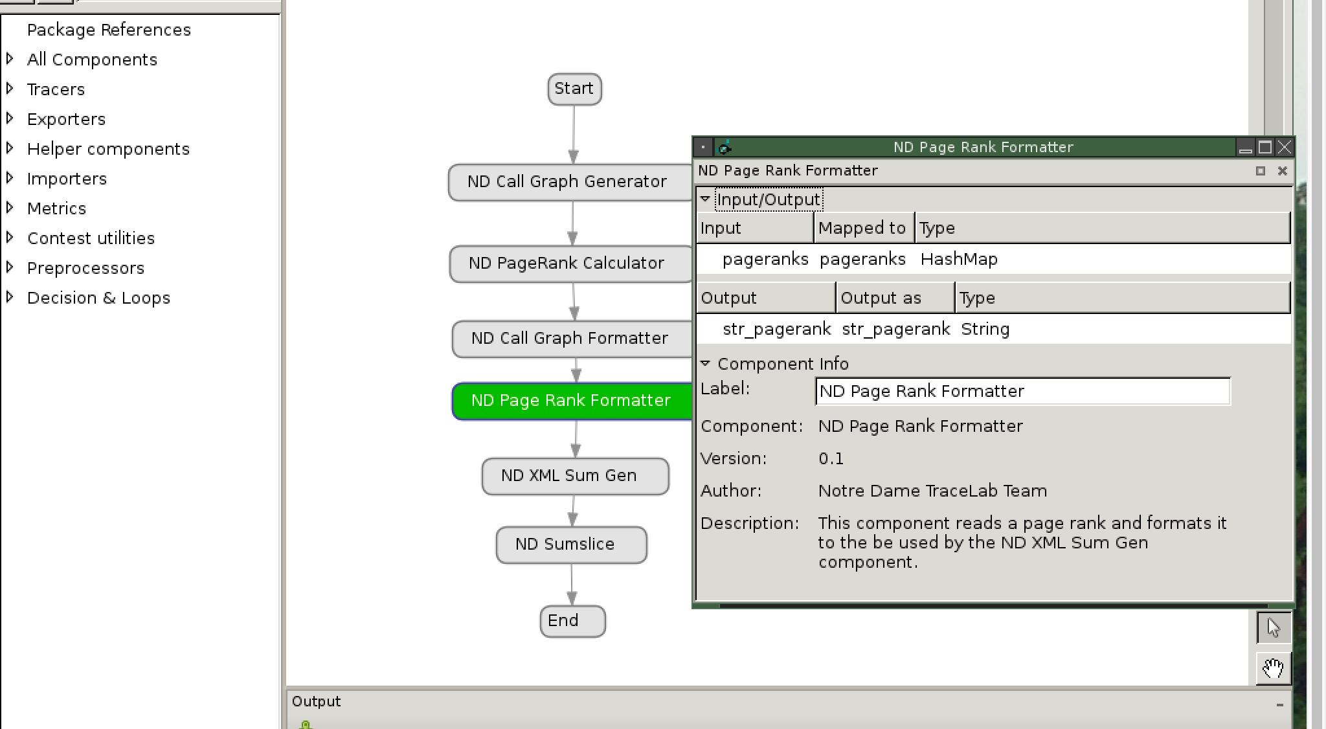
ND Page Rank Formatter

Slide 27
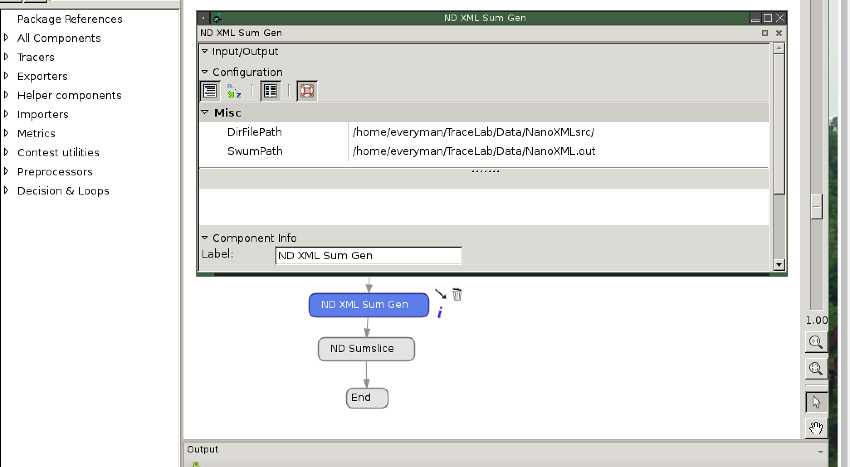
ND XML Sum Gen

Slide 28
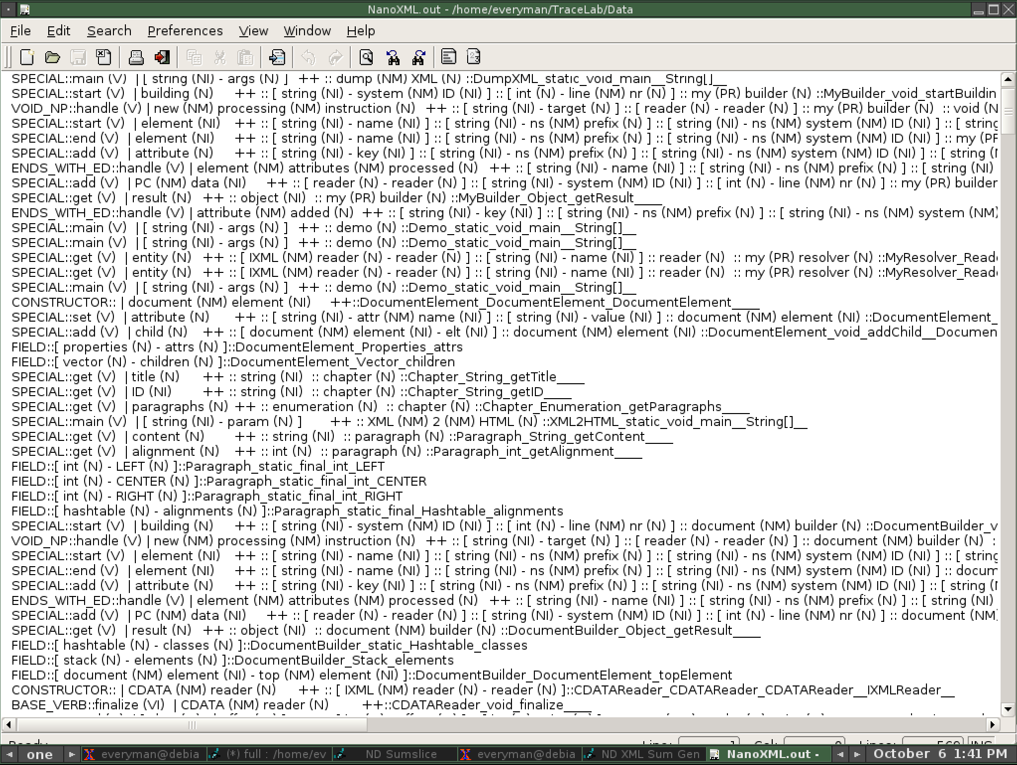
ND XML Sum Gen Input
Notes:
swum

Slide 29
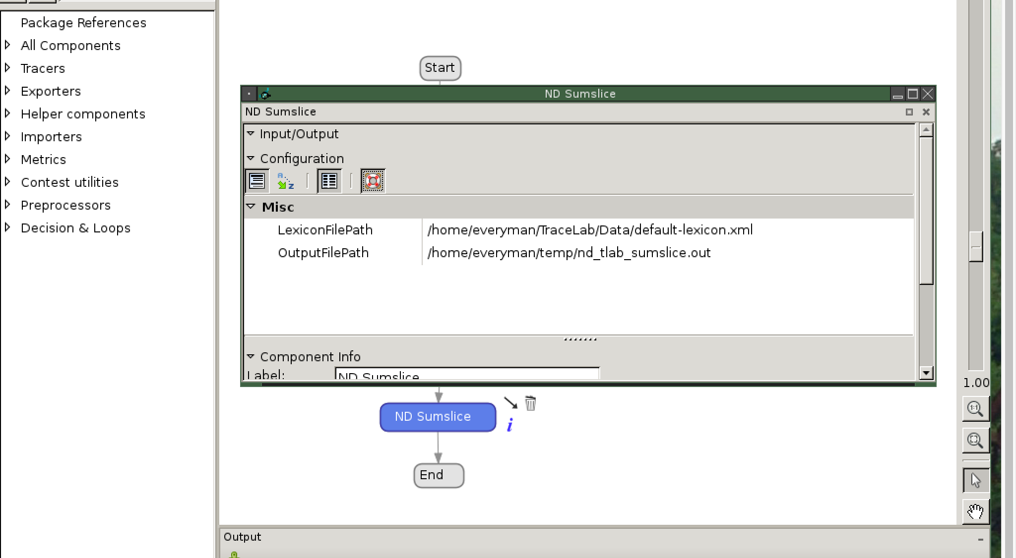
ND Sumslice

Slide 30
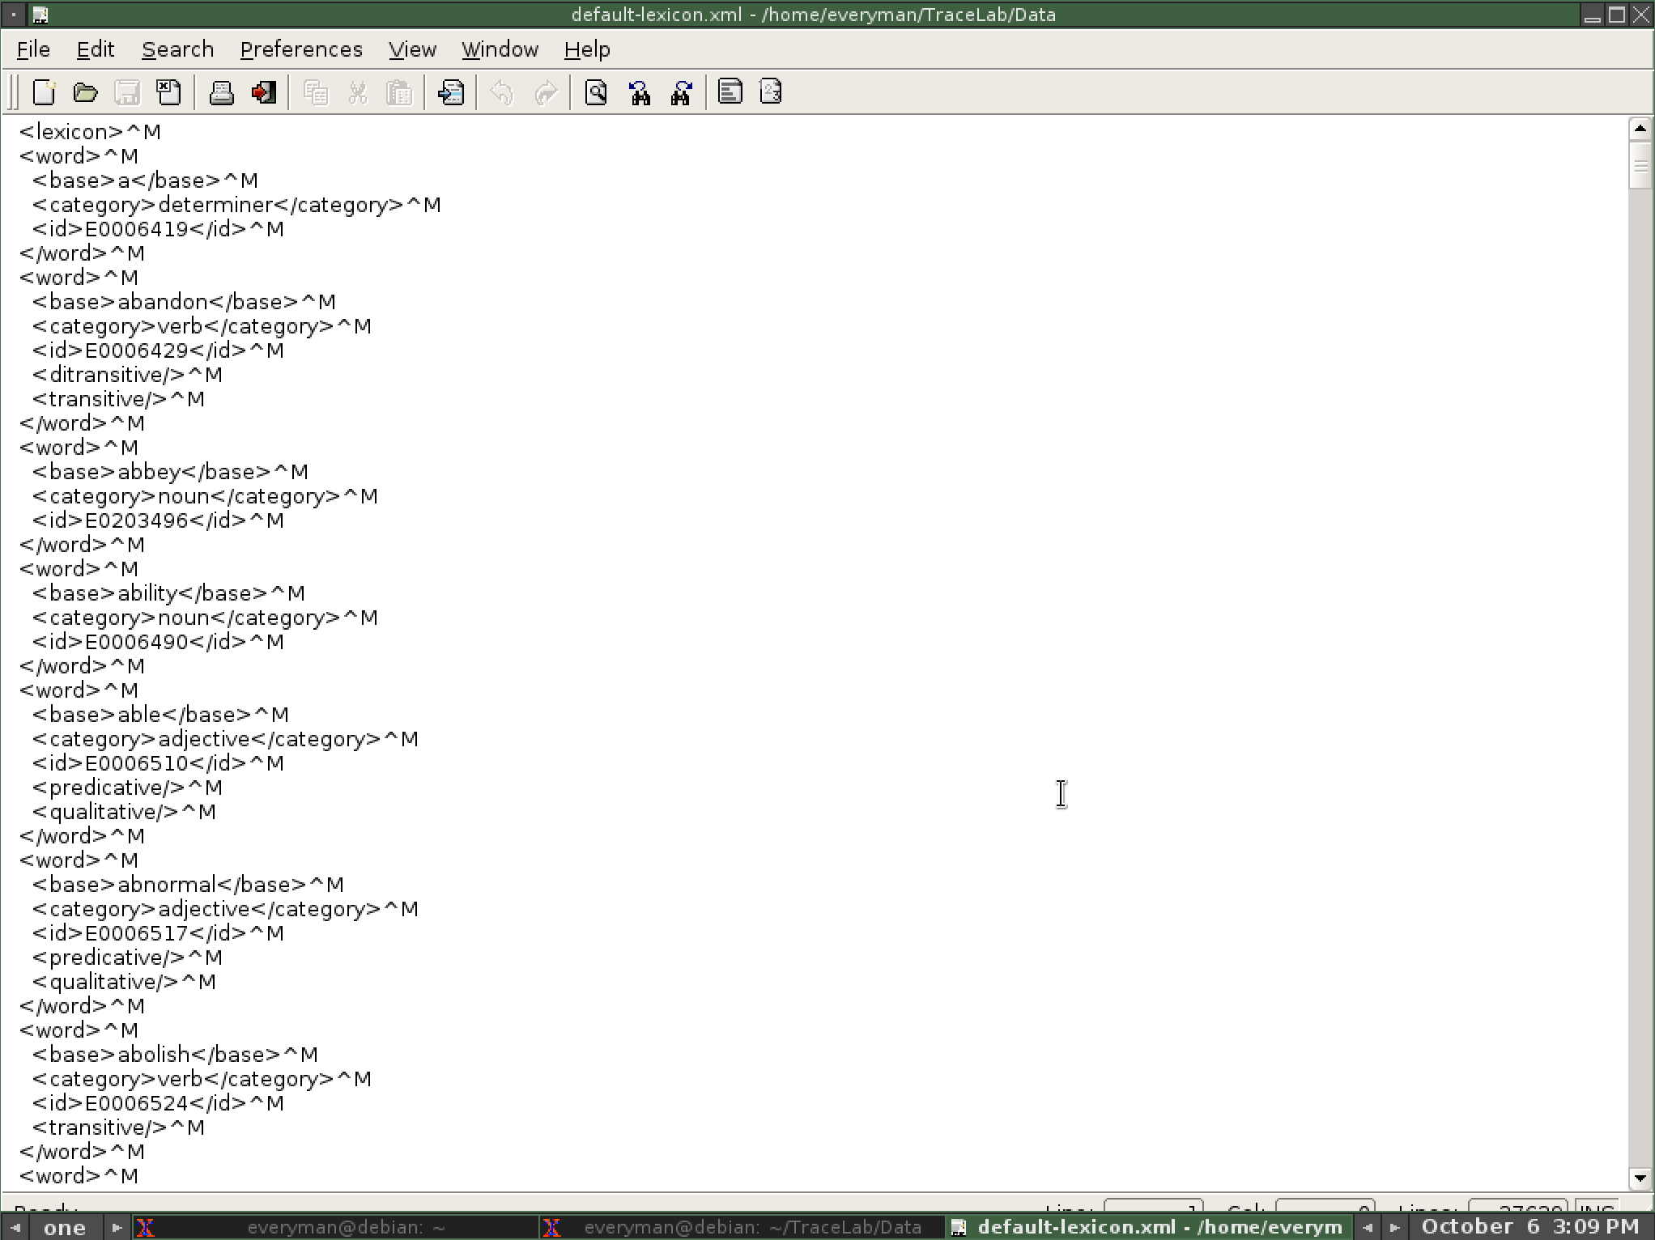
ND Sumslice Input
Notes:
Default-lexicon

Slide 31
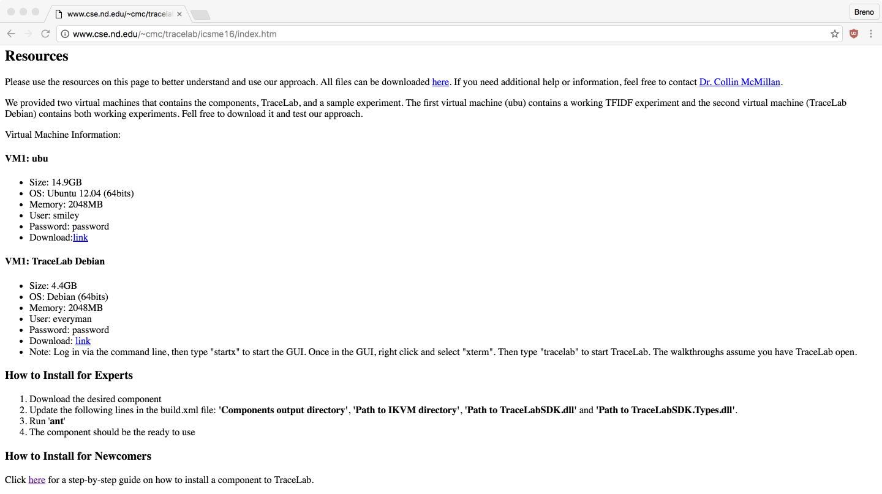
Web Page
http://www.cse.nd.edu/~cmc/tracelab/icsme16/index.htm

